Slide 1


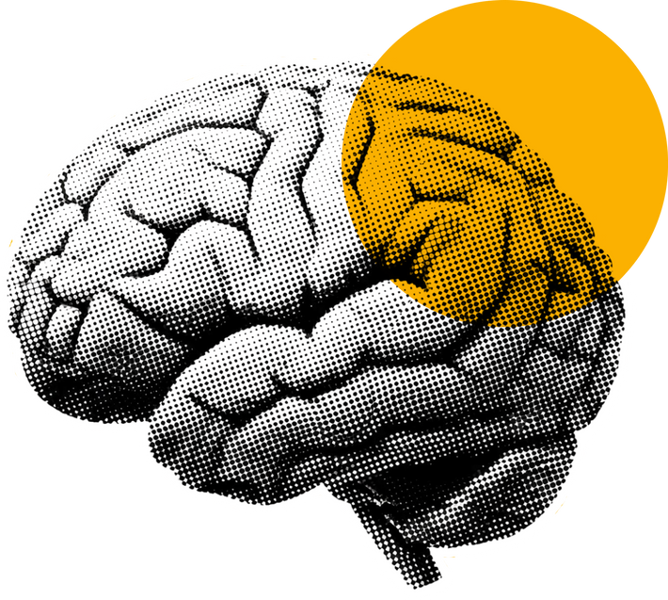
BRAIN CT MEDICAL IMAGING
TUTORIAL
Notes:
Google Colab Notebook: https://colab.research.google.com/drive/1nhxL0uKTXh1jIuQ74hQL8hiiD2ySAuF5?usp=sharing
* This tutorial reproduces an end‑to‑end pipeline: data → model → metrics → inference.
* No clinical claims; outputs are for visualization and learning.

Slide 2
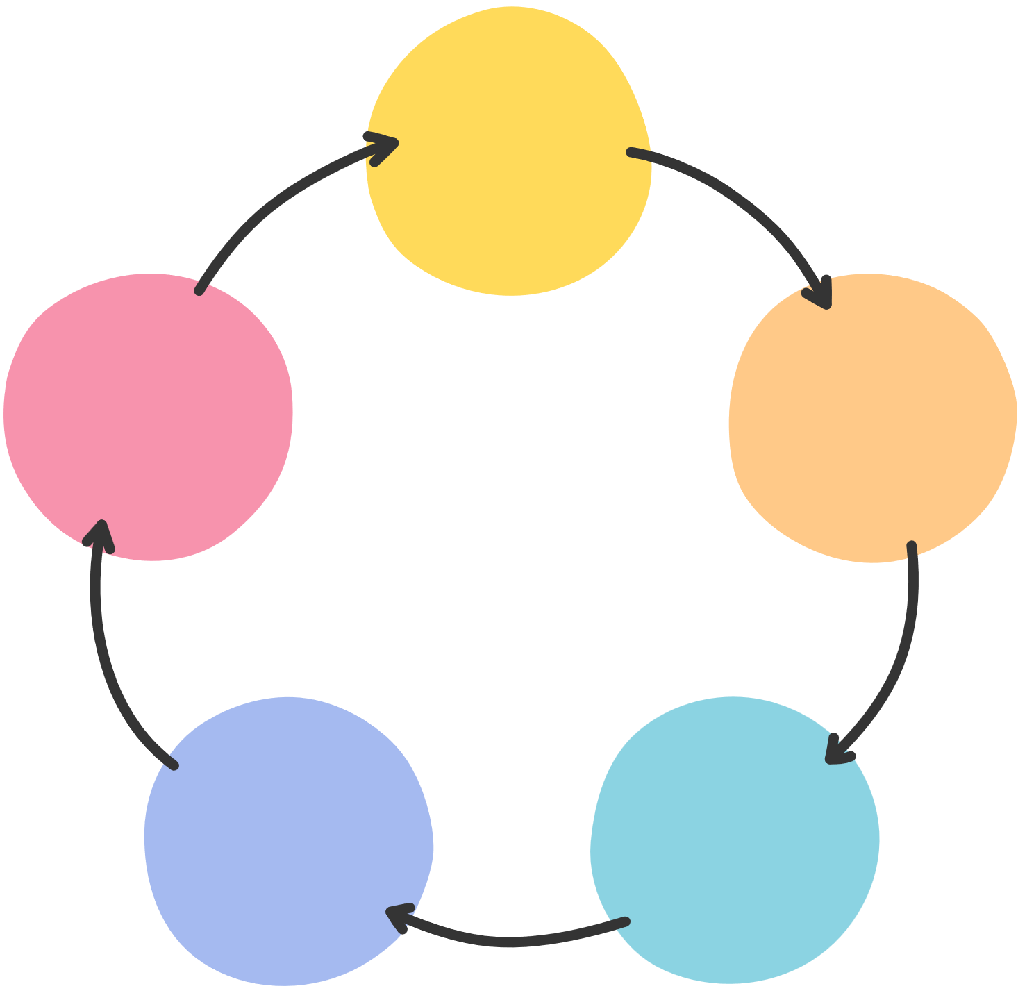
Objective/Agenda
Objectives: Build and teach an image-to-image pipeline; evaluate PSNR/SSIM; while ensuring replicability
Agenda: Data → Dataset/DataLoader → U-Net → Training → Metrics → Results → Reproducibility → Limits
Notes:
* We reconstruct a plausible color mapping from grayscale input; not ground-truth tissue color.
* Success criteria include perceptual quality (triptychs) and quantitative metrics (PSNR higher, SSIM closer to 1).
* This is not classification/segmentation; it’s regression per pixel.

Slide 3

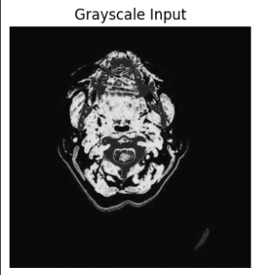
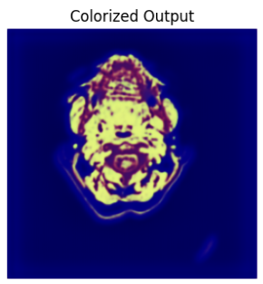
Motivation: Why Colorization?
TEACHABLE IMAGE-TO-IMAGE TASK WITH CLEAR VISUAL EVALUATION
USES U-NET SKIP CONNECTIONS TO PRESERVE DETAIL
NOT A DIAGNOSTIC MODEL
Notes:
* The notebook covers setup, data indexing, model definition, training loop, evaluation, and visualization.
* Each component is modular: you can swap transforms, model depth, or losses without changing the overall flow.

Slide 4

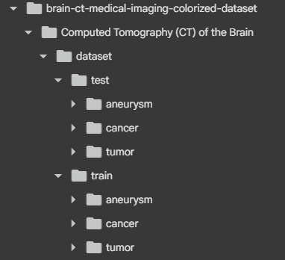
Dataset Overview
Source: Kaggle “Brain CT Medical Imaging Colorized”
License: MIT
Splits/classes: train/test; aneurysm, cancer, tumor
Notes:
* Dataset:
Shuvo Kumar Basak. (2025). Brain CT Medical Imaging Colorized Dataset [Data set]. Kaggle.
https://doi.org/10.34740/KAGGLE/DSV/11886200
* License:
https://www.mit.edu/~amini/LICENSE.md
* Folder layout inside: Computed Tomography (CT) of the Brain/dataset/train|test/<class>.
* We treat class labels as metadata; the target is the original RGB image.
* Ensure you have permission/network access to download via KaggleHub or download manually (this should already be handle in the notebook).

Slide 5

Environment and Dependencies
PYTORCH
SCIKIT-IMAGE
MATPLOTLIB
OPENCV
TQDM
GOOGLE COLAB
Notes:
* The install cell uses pip_install([...]) to fetch required packages quietly.
* torchvision brings Pillow; scikit-image provides PSNR/SSIM; OpenCV handles saving outputs.
* Works on CPU (slower) or GPU (CUDA auto-detected, additionally recommend A100 as that was gpu utilized from google colab for its performance).

Slide 6


Reproducibility & Runtime
ASPECTS TO CONSIDER
Fixed seeds (Python/NumPy/Torch)
Device auto-detect (CPU/GPU)
Colab-aware; optional Drive mount
Notes:
* Seeds: random.seed, np.random.seed, torch.manual_seed, torch.cuda.manual_seed_all are set to 42 (as that is most common value to use as seed).
* Minor metric variance across devices is expected due to non-deterministic GPU.
* In Colab, Drive mount copies the dataset to persistent storage; locally it’s skipped (as you just need to be in directory where you want your jupyter notebook to be).

Slide 7
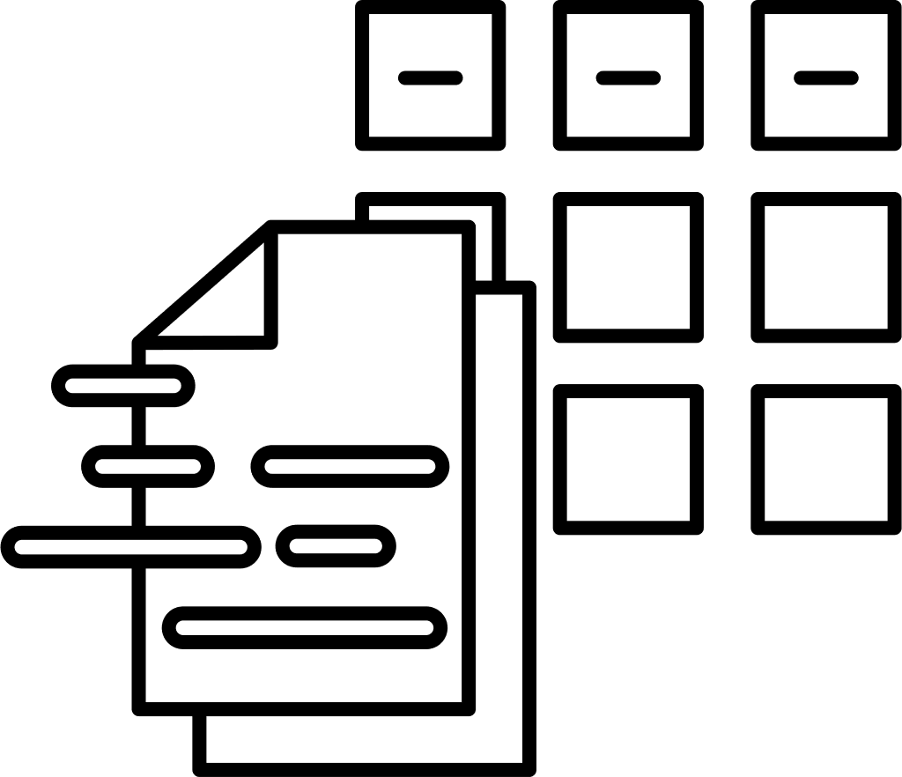


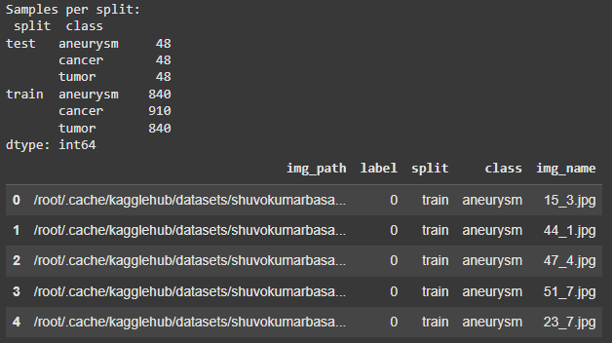
Indexing the Dataset
Build DataFrame with:
img_path, split, class, label, img_name
Filter png/jpg/jpeg
Print counts per split/class
Notes:
* labels: [aneurysm, cancer, tumor] are mapped to integers 0–2 for convenience (unused in loss).
*df.groupby(["split","class"]).size() quickly validates distribution and highlights missing folders.
* df.head() is shown to preview paths and columns.

Slide 8
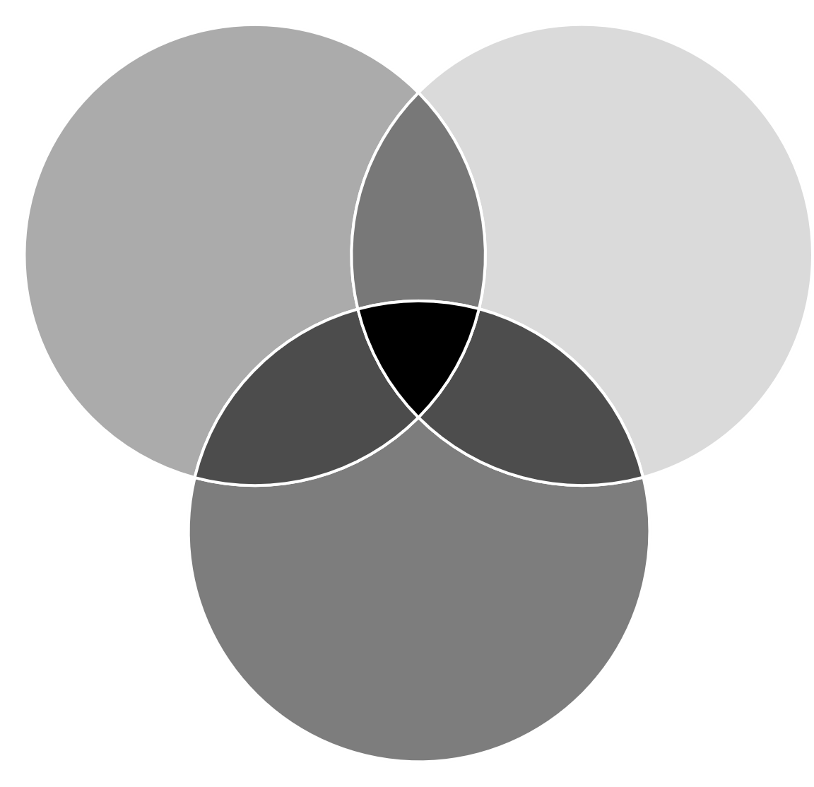
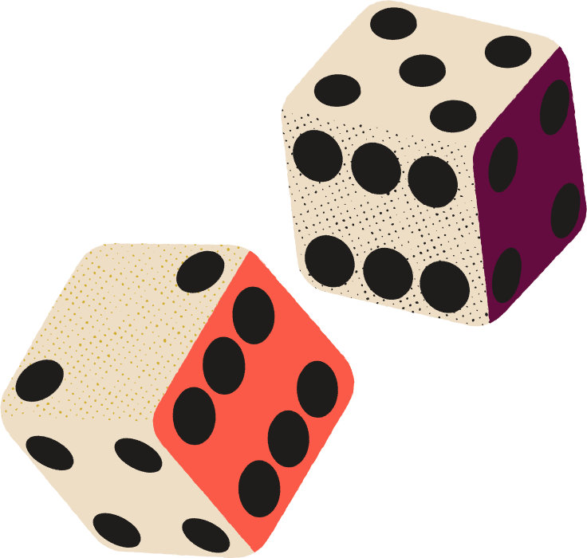
Custom Dataset (CTScanDataset) Class
FUNCTIONALITY
Input: RGB → grayscale (L)
Target: original RGB
Normalize to [-1,1]
Optional paired flips (train)
Notes:
* transform_input: Resize → ToTensor → Normalize((0.5,), (0.5,)) for single-channel.
* transform_target: Resize → ToTensor → Normalize((0.5,0.5,0.5), (0.5,0.5,0.5)).
* The grayscale tensor is replicated to 3 channels via torch.cat([x]*3, dim=0) to match the U‑Net’s 3‑channel input.
*Augmentations use functional.hflip/vflip and must be applied to input and target consistently.

Slide 9
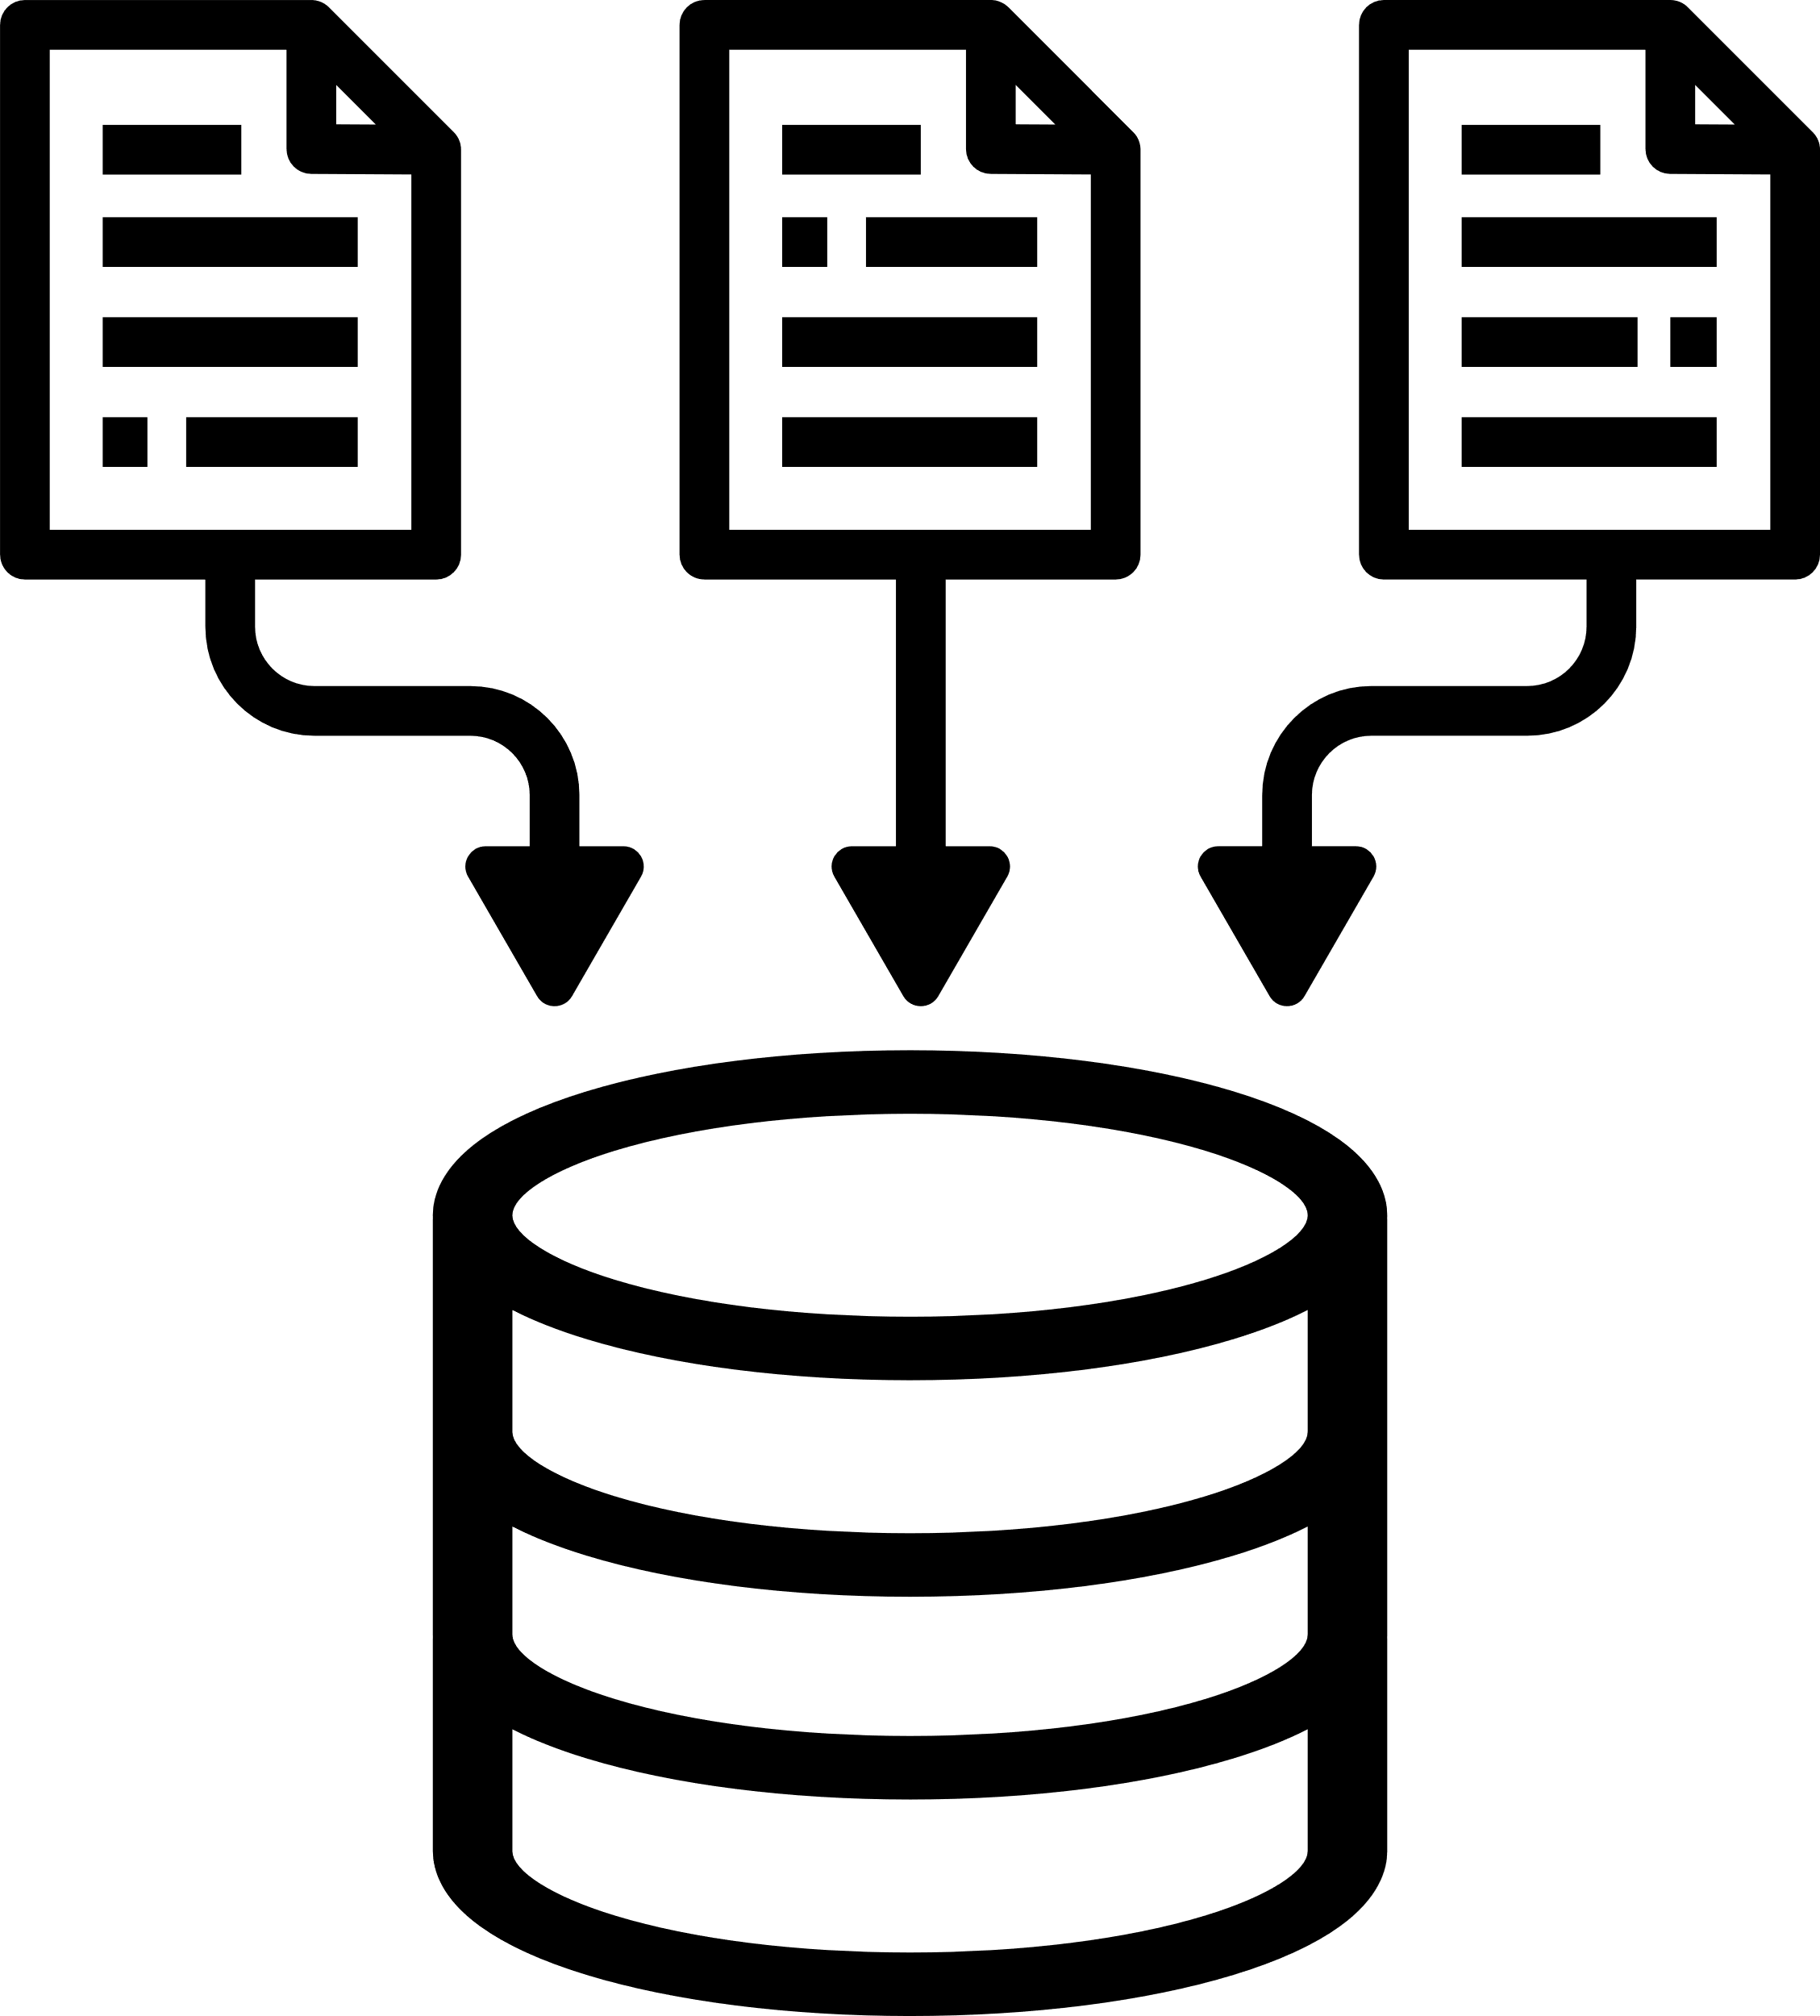
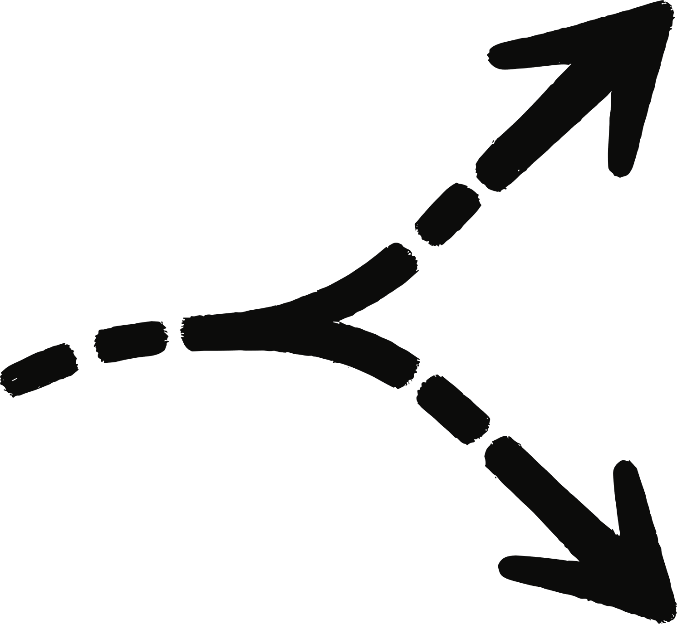
DataLoaders & Splits
DATALOADERS
shuffle == True for train
shuffle == False for val
pin_memory == True speeds host→GPU transfers
SPLITS
Train: split==train, augment=True
Val: split==test, augment=False
batch_size, num_workers, pin_memory
Notes:
* train_df and val_df are filtered from df and reindexed.
* Adjust batch size to avoid OOM; start with 16 or 32 on 256×256 images.

Slide 10
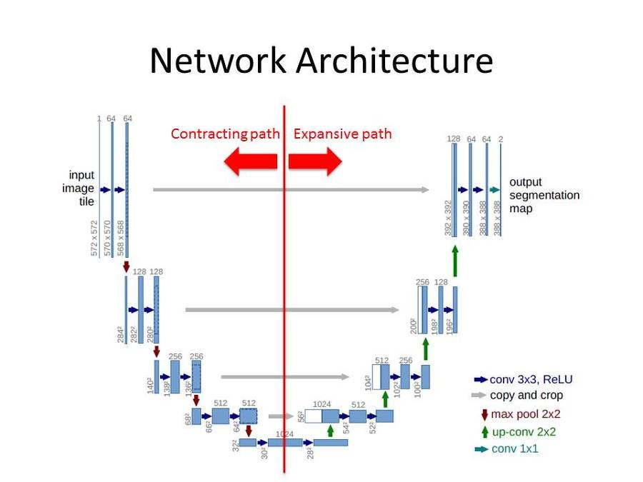
U‑Net Architecture
Encoder: 64→128→256→512
Bottleneck: 1024
Decoder: up-conv + skip concat
Output: 3‑ch + tan(h)
Notes:
* Classes: ConvBlock, EncoderBlock, DecoderBlock, UNetColoriser.
* Skip connections concatenate encoder features with upsampled decoder features (channel dim).
* Final activation is tanh to constrain output to [-1,1], matching normalization.
* Note image on slide is general visual of u-net architecture.

Slide 11

Loss & Optimization
CombinedLoss = α·L1 + (1−α)·MSE
α = 0.4 (edges vs smoothness)
AdamW lr=1e‑4, wd=1e‑5
StepLR(step=10, γ=0.5)
Notes:
* CombinedLoss balances sharpness (L1) and stability (MSE).
* AdamW provides decoupled weight decay; good default for vision tasks.
* The scheduler is conservative and easy to reason about for demos.

Slide 12

Metrics
Map outputs to [0,1] for metrics
PSNR (higher is better)
SSIM (0–1; higher is better)
Notes:
* tensor_to_img01 clamps, rescales, and permutes tensors to H×W×C numpy in [0,1].
* skimage.metrics: peak_signal_noise_ratio and structural_similarity(channel_axis=2).
* Metrics are accumulated per-image over the validation set and averaged.

Slide 13
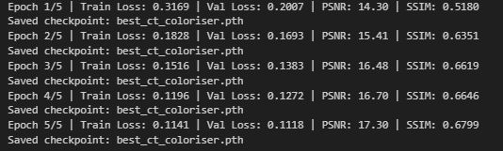
Training Loop & Checkpoint
Epoch log: train loss, val loss, PSNR, SSIM
Save best model by val loss
Demo: 5 epochs (increase for quality)
Notes:
* NUM_EPOCHS=5, BATCH_SIZE=16, IMG_SIZE=256 are set near the training cell.
* best_ct_coloriser.pth is saved when val loss improves; StepLR advances each epoch.
* Validation runs in torch.no_grad(); metrics computed on each image in the batch.

Slide 14

Inference Pipeline
Load weights → preprocess L → replicate → predict
Postprocess tanh → [0,1]
Save with OpenCV (BGR)
Notes:
* inference(model_path, input_path, output_path, img_size, device) wraps the full flow.
* Preprocess mirrors training: Resize → ToTensor → Normalize((0.5,), (0.5,)) then replicate to 3 channels.
* cv2.imwrite expects BGR; the code reverses channels with [:, :, ::-1].

Slide 15
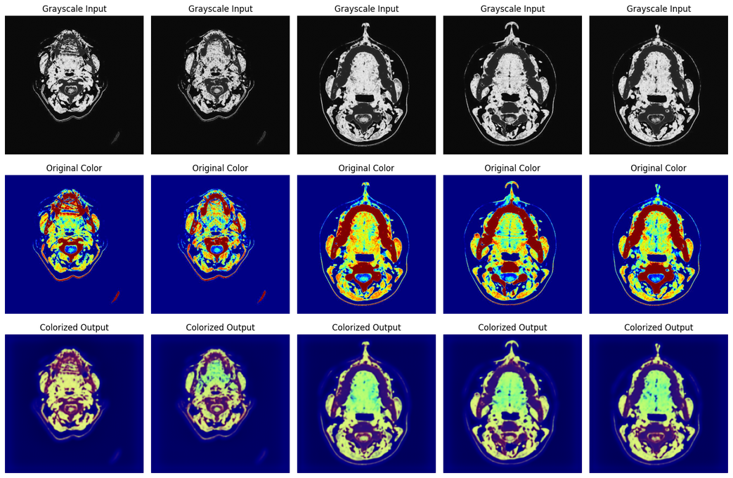
Result Visualization
Triptych:
Grayscale | Original | Colorized
Sample from val set
Save outputs to folder
Notes:
* Randomly samples test indices; ensures a checkpoint exists (or saves current weights).
* Writes input/target/output PNGs to colorized_outputs for inspection and reuse.
* Illustrate strengths of model (edges, bone/soft tissue textures) and failure modes (hue drift).

Slide 16

Limitations & Ethics
Learned color ≠ true physiology
Dataset/domain bias
Not for immediate clinical use
Notes:
* Colors are model predictions trained on curated RGB images; they do not represent real tissue chromatics.
* Domain shift across scanners/protocols may degrade results; no true clinical validation here.
* Use clear labels and disclaimers when sharing visuals.

Slide 17

THANK YOU!

